Slide 1
Confidence Detection System
Real-time Multimodal Confidence Analysis
Faculty of Science and Technology, Dept. of Computer Science
Undergraduate thesis
Student Name | ID
1. RUBAYET ALAM AZAN | 22-46888-1
2. S.M. NAFEES HOSSAIN NILOY | 22-47333-2
3. AL FAHAD | 22-47125-1
4. ABDULLAH AL MARJUC TALHA | 22-47294-1
01

Slide 2
Content
Problem Definition
Motivation
Research Questions
Proposed Methodology
Architecture of Using Algorithm
Data Analysis
Results
Limitation
Future Work
Conclusion
02

Slide 3

Problem Definition
Users’ confidence is difficult to evaluate in remote environments.
Existing systems rely on single modality → low accuracy & high noise sensitivity.
Deep learning-based systems:
Expensive
Hard to interpret
Requires large datasets
Need a lightweight, interpretable, real-time confidence detection system.
03

Slide 4

Motivation
Demand for real-time feedback in:
Online interviews
Virtual classrooms
Telemedicine
Presentation training
Multimodal analysis (face + hand + voice) gives more reliable insights than unimodal systems.
A rule-based, transparent system improves interpretability and ease of deployment.
04

Slide 5

Research Questions
Can real-time behavioral signals accurately estimate confidence?
Does multimodal fusion outperform unimodal systems?
Can lightweight, browser-based tools achieve consistent performance?
What factors correlate most strongly with human-perceived confidence?
Can this system be applied in practical real-world digital interactions?
05

Slide 6
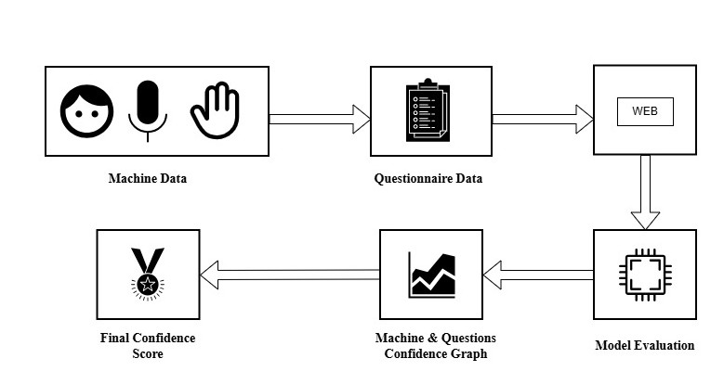
Proposed Methodology
06

Slide 7
Architecture Of Used Models
1. Input Acquisition
Webcam Video → Facial & Hand data
Microphone Audio → Vocal data
Questionnaire Form → 15-item self-assessment score
2. Machine Data Processing
Facial Analysis: gaze, blink rate, head pose, lip movement
Hand Gesture Analysis: gesture speed, smoothness, stability
Vocal Analysis: pitch, jitter, loudness, spectral centroid
3. Feature Extraction
Extract numerical metrics from each modality
Normalize values for scoring
4. Machine Confidence Score (Weighted Fusion)
Vocal Features → 40%
Facial Features → 30%
Hand Gestures → 30%
5. Questionnaire Confidence Score (Q-Score)
Self-reported confidence from 15 questions
Used for validation and combined scoring
6. Final Score = Machine Score (40%+30%+30%)
Produce real time confidence level
07

Slide 8
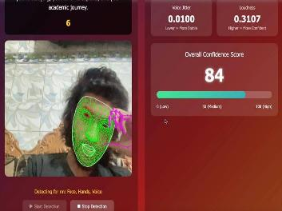
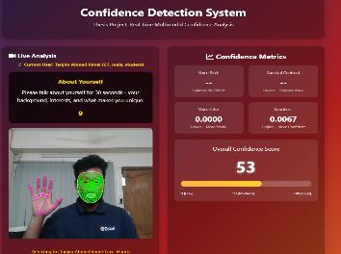
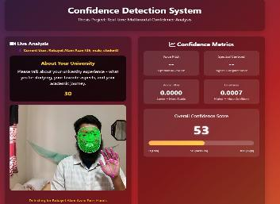
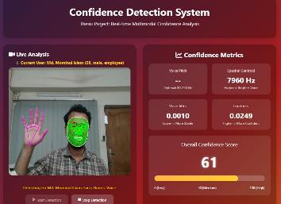
Data Analysis
Machine Data Analysis
08

Slide 9
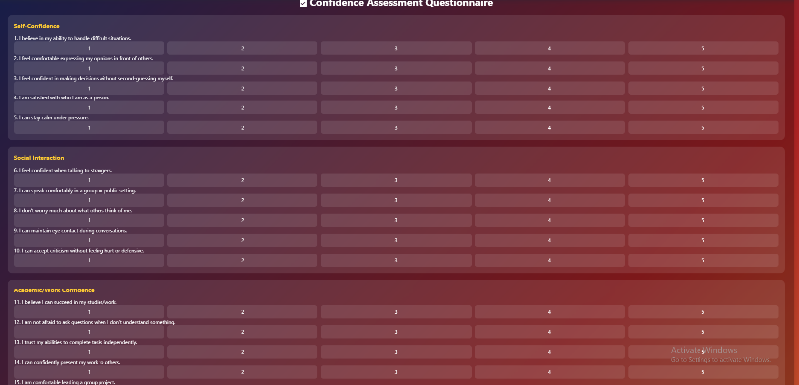
Data Analysis
Questionnaire Data Analysis
09

Slide 10
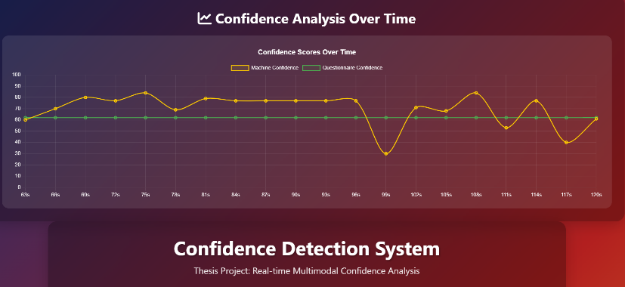
Data Analysis
Combined Confidence Evaluation
10

Slide 11
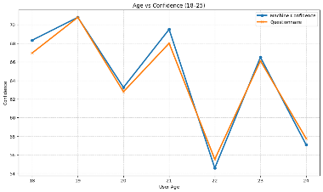
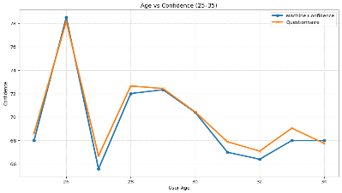
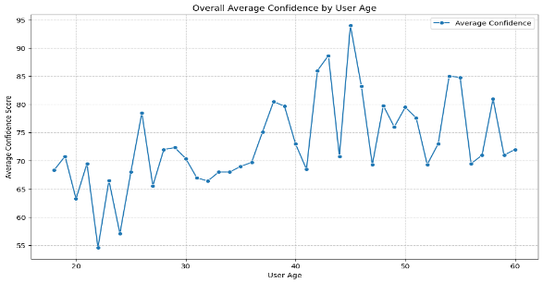
Result
11

Slide 12
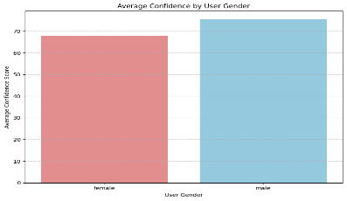
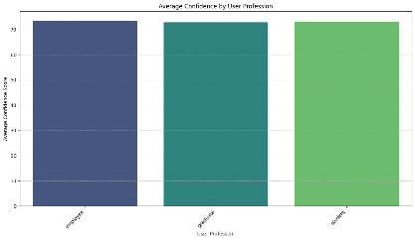
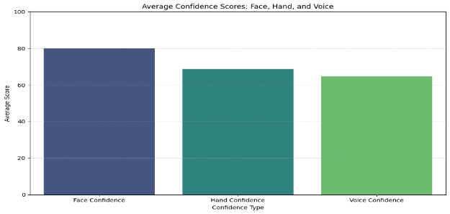
Result
12

Slide 13
Result
Overall Modality Performance
Face Confidence: 80.13% Hand Confidence: 68.81% Voice Confidence: 64.87% Facial cues contributed the most stable & accurate confidence signals. Accuracy: 94.97%
User Demographic Insights Gender: Male: 76% | Female: 68% Slight male advantage in non-verbal stability. Profession: Employees, Graduates, Students all scored 72–74% No major profession bias detected.
13

Slide 14


Limitations
Dataset size limited (100 participants).
Lighting variation affects detection accuracy.
System performance varies with webcam quality.
Complex emotional states still difficult to detect.
Limited cultural & demographic data diversity.
Future work
Multi-face detection for group meetings.
Advanced hand gesture classification.
Eyebrow movement & micro-expression analysis.
More visual overlays and real-time coaching.
Train on larger, culturally diverse datasets.
Mobile app implementation.
14

Slide 15
Conclusion
Developed a real-time multimodal confidence detection system.
Integrates facial, hand, and vocal cues → high accuracy.
Lightweight, interpretable, browser-based solution.
Useful for online interviews, virtual learning, public speaking.
Sets foundation for future research in behavioral AI & HCI.
15

Slide 16
References
M. Archana, C. Nitish, S. Harikumar, Real time face detection and optimal face mapping for online classes, in: Journal of Physics: Conference Series, Vol. 2161, IOP Publishing, 2022, p.012063.
C. Zheng, W. Wu, C. Chen, T. Yang, S. Zhu, J. Shen, N. Kehtarnavaz, M. Shah, Deep learningbased human pose estimation: A survey, ACM Computing Surveys 56 (1) (2023) 1–37.
Zhu, X., Liu, Z., Cambria, E., Yu, X., Fan, X., Chen, H., & Wang, R. (2024). A client-server based recognition system: Non-contact single/multiple emotional and behavioral state assessment methods. Computer methods and programs in biomedicine, 260, 108564.
Sakib, T., Mojumder, S., Gupta, R., Showmick, M., Rahat, M., & Hossen, M. (2025). Real-Time Confidence Detection through Facial Expressions and Hand Gestures. ArXiv, abs/2506.09153.
Rani, K., Muralidhar, A., Rao, G., Shareef, S., Sudheer, P., & Bhavsingh, M. (2025). Real-Time Emotion Detection in Live Video Streams using Multimodal Deep Learning Architectures. 2025 5th International Conference on Pervasive Computing and Social Networking (ICPCSN), 1445-1452.
Kraack, K. (2024). A Multimodal Emotion Recognition System: Integrating Facial Expressions, Body Movement, Speech, and Spoken Language. ArXiv, abs/2412.17907.
Villegas-Ch., W., Gutierrez, R., & Mera-Navarrete, A. (2025). Multimodal Emotional Detection System for Virtual Educational Environments: Integration Into Microsoft Teams to Improve Student Engagement. IEEE Access, 13, 42910-42933.
16

Slide 17
Thank you
17

